Slide 1
BCI433 - IBM i Business Computing
Week 8: RPGLE Business Application of OLTP

Slide 2
Agenda
RPGLE Interactive Program File Update
Lab 7
Lab 8

Slide 3
Lesson Objectives
Upon completion of this lecture and lab 7/Lab8 you'll be able to:
Implement a RPGLE business application with OLTP process
Use a CLLE driver program to automate testing of the update program
Examine the journaled changed made to the master file

Slide 4
Term – Master File
Master file:
The data or database file that holds a collection of records pertaining to one of the main subjects of a business application system, such as Customers, Employees, Products, and etc.
Master files contain
descriptive data, e.g. name, address
summary information, e.g. amount due, year-to-date sales

Slide 5
Term – Transaction File
Transaction file:
The data or database file that holds a collection of transaction records.
The data in transaction files is used to update the master files.
Transaction files also serve as audit trails and history for the organization
Transaction file examples - typical transaction records:
EMPLOYEE PAYROLL RECORD
ORDER RECORD
PURCHASE ORDER

Slide 6
Term – OLTP
OLTP stands for On-line Transaction Processing
An OLTP system is usually a core information system of an organization.
For example, a banking accounting system in a bank, which supports customers to make payments, …
IBM i Power System server is designed for supporting On-line Transaction Processing (OLTP) systems.
The term OLTP is opposite to OLAP (e.g. data warehouse, data mining systems)

Slide 7
DB2 Collection
A collection is created using SQL statement
a library on IBM i operating system
Copying physical file across collections:
In 'green/white' screen, type 'CPYF' then press F4 key. See next slide for details.
Then press F9 to get the complete command, which needs to be placed into the CLLE driver program.
Note: make sure to run the command and add the collection to the RDi's library list before you comile the RPGLE program.

Slide 8
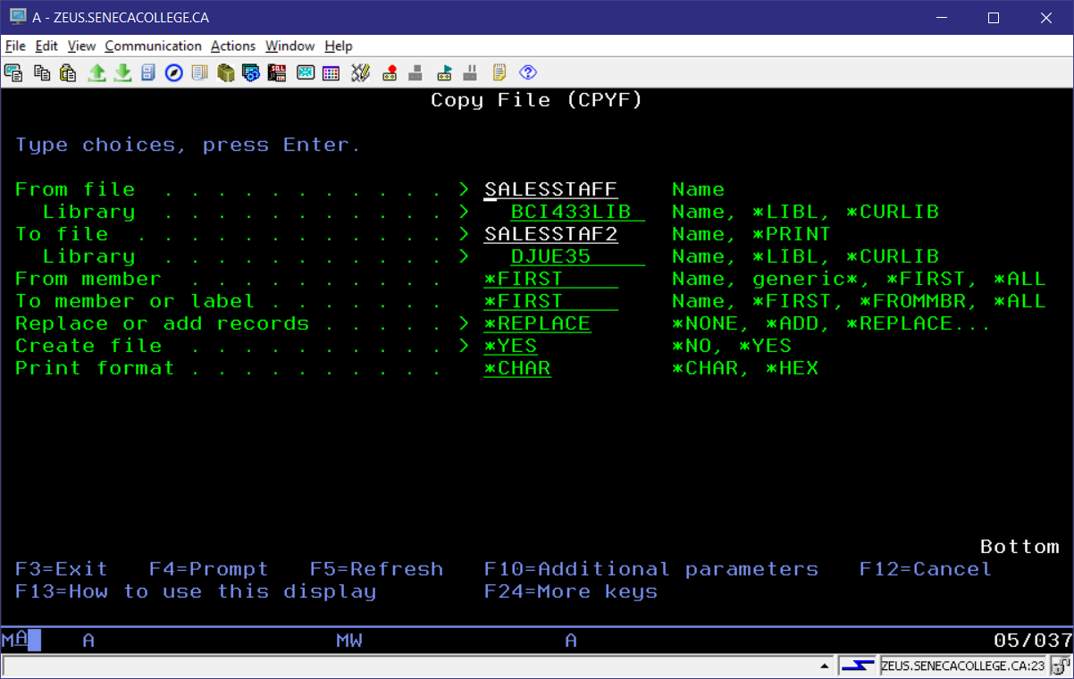
Copying physical file across collections

Slide 9
RPG commands
to add a record to a database file
WRITE record-format-name
to change a record from a database file
UPDATE RCDFMT(SHIFTWEEK)
to remove a record from a database file
DELETE SHIFTWEEK

Slide 10
RPG Functions
%DEC
%FOUND
%EOF
%KDS
%ERROR

Slide 11
CL commands
DSPFFD
STRSQL
RUNQRY
DSPJRN

Slide 12
Homework
Review lecture notes.
Lab 7
Start Lab 8 – it will be due in three weeks

Slide 13
Lab 7 Demo

Slide 14
The End

